Slide 1
Applied Statistics
week2
Nov 2017
Serkan Ceran
www.serkanceran.com
https://www.linkedin.com/in/serkan-ceran
@analytcman
All client case studies included in
this training are for internal use only

Slide 2
1-Normal Distribution

Slide 3
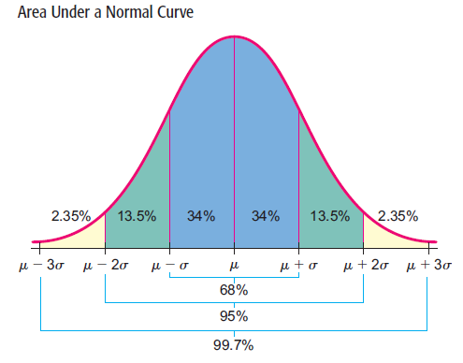
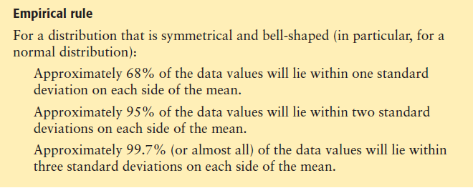
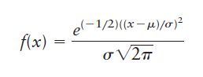
The Bell-shaped curve: Normal distribution
We saw Chebyshev’s theorem. This theorem gives us information about the smallest proportion of data that lies within 2, 3, or k standard deviations of the mean. This result applies to any distribution. However, for normal
distributions, we can get a much more precise result, which is given by the empirical rule.
normal density function
Notes:
3
3
COMMENT The normal distribution curve is always above the horizontal axis. The area beneath the curve and above the axis is exactly 1. As such,
the normal distribution curve is an example of a density curve. The formula used to generate the shape of the normal distribution curve is called the
normal density function. If x is a normal random variable with mean m and standard deviation s, the formula for the normal density function is:

Slide 4
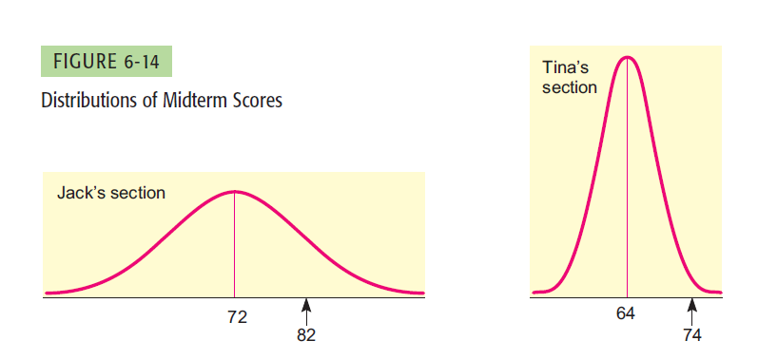
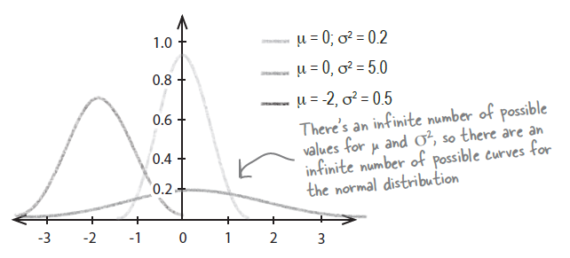
The Bell-shaped curve: Normal distribution
There are an infinite number of possible values for μ and σ2, and as the normal curve uses these as parameters to indicate the center and spread of the curve, there are also an infinite number of possible normal distribution curves.
It would be a futile task to try to set up a table of areas under the normal curve for each different m and s combination. We need a way to standardize the distributions so that we can use one table of areas for all normal distributions. We achieve this standardization by considering how many standard deviations a measurement lies from the mean. In this way, we can compare a value in one normal distribution with a value in another, different normal distribution.
Notes:
4
4

Slide 5
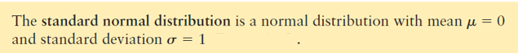
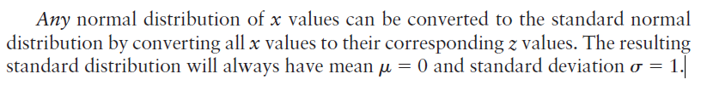
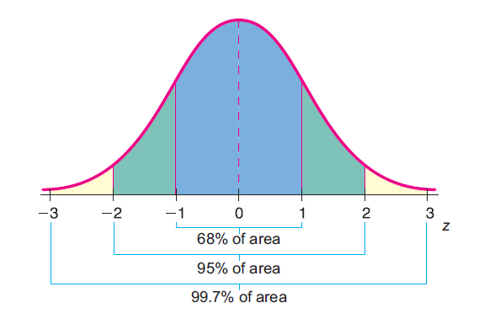
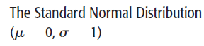
Standard Normal Distribution
If the original distribution of x values is normal, then the corresponding z values have a normal distribution as well. The z distribution has a mean of 0 and a standard deviation of 1. The normal curve with these properties has a special name.
There are extensive tables that
show the area under the standard normal curve for almost any interval along the z axis.
Notes:
5
5

Slide 6
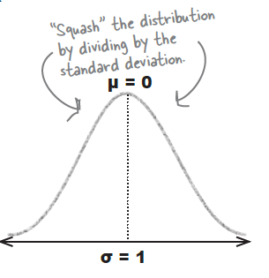
Example: The z-score for an IQ of 150
Google have an entry requirement of an IQ of 150. What percent of the Turkey population are likely to be allowed to join?
To do this, we need to work out how many standard deviations above the mean a score of 150 is. . . .(this is also called a z-score)
x_{i} – x
z =
s.d.
150 – 100
IQ Scores
Mean: 100
s.d: 20
z =
20
= 2.5 std devs
above mean
50
100
150
Notes:
6
6

Slide 7
Example: The z-score for an IQ of 150
The percent of values above or below a certain value of standard deviations from the mean is always the same
So, what does this mean? A computer tells us the answer (or a book with a z-table in it, if you’re an old-school statistician)
Only 0.6% of the population would have an IQ at least 2.5 standard devs above average
IQ Scores
Mean: 100
s.d: 20
Similarly, only 0.6% would have an IQ below 50
(2.5 standard devs below average)
0.6% of scores
0.6% of scores
-2.5sd
0
+2.5sd
98.8% of scores
Notes:
7
7

Slide 8
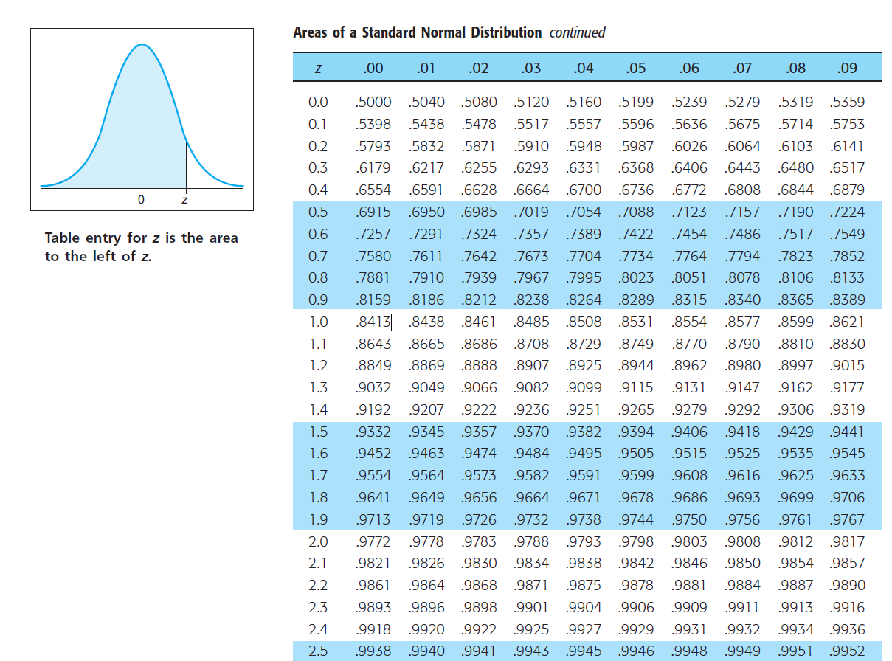
Notes:
8
8

Slide 9
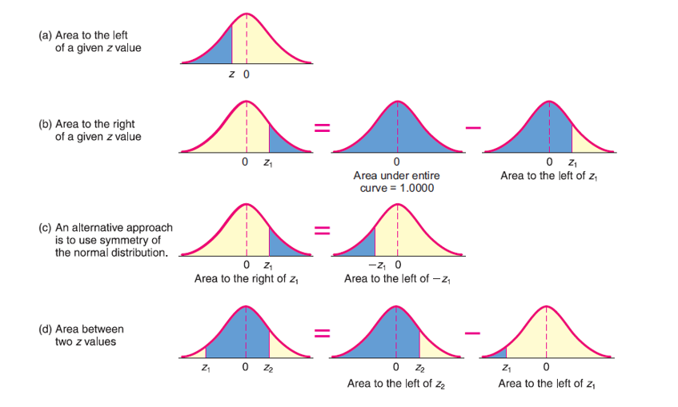
Notes:
9
9

Slide 10
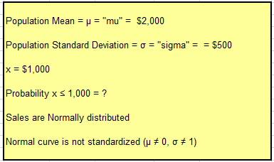
Problem1
Problem: A store has normally distributed daily sales. The average daily sales = $2,000 and the daily sales standard deviation = $500, What is the probability that the sales of one random day will be below $1,000?
Notes:
10
10

Slide 11
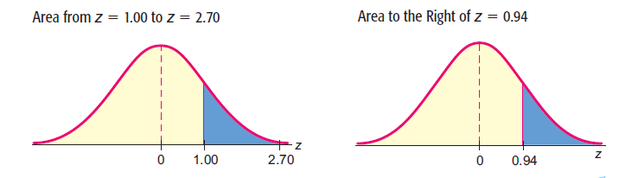
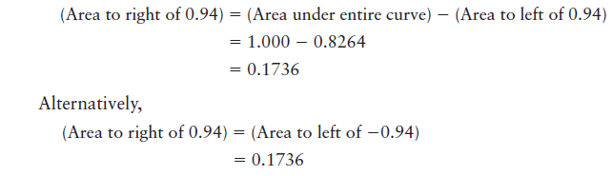
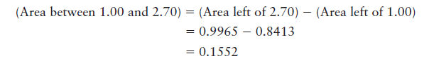
Problem2
a) Find the area between z = 1.00 and z= 2.70
b) Find the area to the right of z = 0.94.
Notes:
11
11

Slide 12
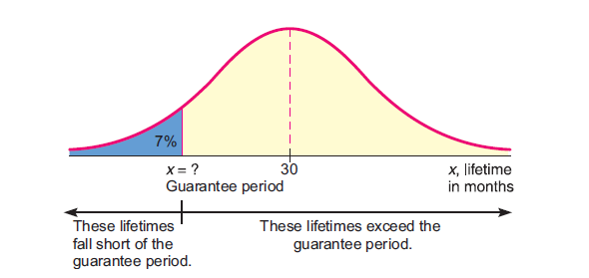
Find x, given probability
Magic Video Games, Inc., sells an expensive video games package. Because the package is so expensive, the company wants to advertise an impressive guarantee for the life expectancy of its computer control system. The guarantee policy will refund the full purchase price if the computer fails during the guarantee period. The research department has done tests which show that the mean life for the computer is 30 months, with standard deviation of 4 months. The computer life is normally distributed. How long can the guarantee period be if management does not want to refund the purchase price on more than 7% of the Magic Video packages?
Notes:
12
12

Slide 13
2. Sampling Distribution and Interval Estimation

Slide 14
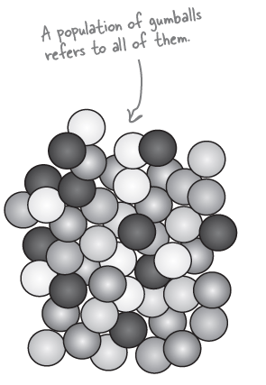
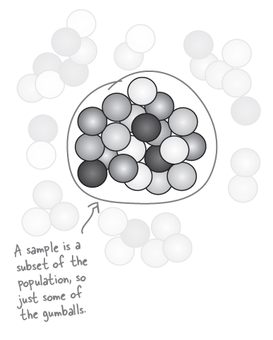
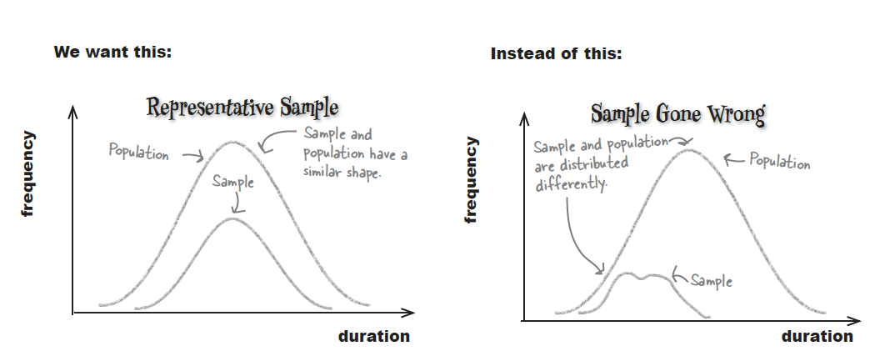
Sampling
Random Sample
Notes:
14
14

Slide 15
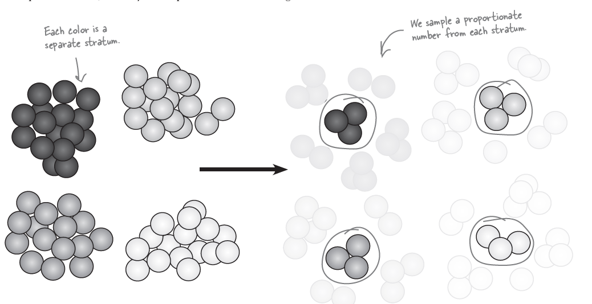
Stratified Sampling
An alternative to simple random sampling is stratified sampling. With this type of sampling, the population is split into similar groups that share similar characteristics. These characteristics or groups are called strata, and each individual group is called a stratum. As an example, we could split up the gumballs into the different colors, yellow, green, red, and pink, so that each color forms a different stratum. Once you’ve done this, you can perform simple random sampling on each stratum to ensure that each group is represented in your overall sample. To do this, look at the proportions of each stratum within the overall population and take a proportionate number from each.
Notes:
15
15

Slide 16
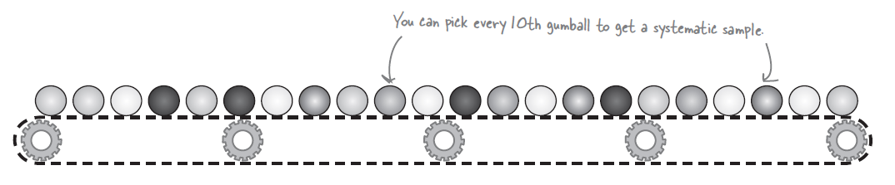
Systematic Sampling
With systematic sampling, you list the population in some sort of order, and then survey every kth item, where k is some number.
Systematic sampling is relatively quick and easy, but there’s one key disadvantage. If there’s some sort of cyclic pattern in the population, your sample will be biased. As an example, if gumballs are produced such that every 10th gumball is red, you will end up only sampling red gumballs, and this could lead to you drawing misleading conclusions about your population.
Notes:
16
16

Slide 17
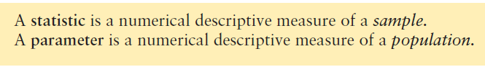
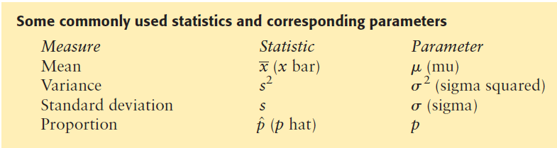
Reminder
Notes:
17
17

Slide 18
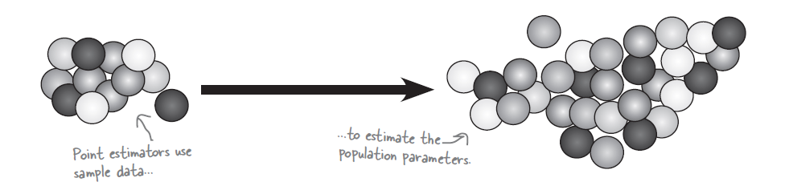
Point Estimators
A point estimator of a population parameter is some function or calculation that can be used to estimate the value of the population parameter. As an example, the point estimator of the population mean is the mean of the sample, as we can use the sample mean to estimate the population mean.
Notes:
18
18
Up until now, we’ve been dealing with actual values of population parameters such as the mean, μ, or the variance, σ2. We’ve either been able to calculate
these for ourselves, or we’ve been told what they are. This time around we don’t know the exact value of the population parameters.
Instead of calculating them using the population, we estimate them using the sample data instead. To do this, we use point estimators to come up with a
best guess of the population parameters.

Slide 19
Point Estimators
The sample of samples might look something like this
POPULATION
1, 2, 3, 4
Average = 2.5
Sample 1
Sample 2
Sample 3
1, 2
1, 3
1, 4
Average = 1.5
Average = 2.0
Average = 2.5
Sample 4
Sample 5
Sample 6
2, 3
2, 4
3, 4
Average = 2.5
Average = 3.0
Average = 3.5
Notes:
19
19
Up until now, we’ve been dealing with actual values of population parameters such as the mean, μ, or the variance, σ2. We’ve either been able to calculate
these for ourselves, or we’ve been told what they are. This time around we don’t know the exact value of the population parameters.
Instead of calculating them using the population, we estimate them using the sample data instead. To do this, we use point estimators to come up with a
best guess of the population parameters.

Slide 20
Exercise . . . .
What is the average of all the sample means?
Average = ?
Sample 1
Sample 2
Sample 3
1, 2
1, 3
1, 4
Average = 1.5
Average = 2.0
Average = 2.5
Sample 4
Sample 5
Sample 6
2, 3
2, 4
3, 4
Average = 2.5
Average = 3.0
Average = 3.5
Notes:
20
20
Up until now, we’ve been dealing with actual values of population parameters such as the mean, μ, or the variance, σ2. We’ve either been able to calculate
these for ourselves, or we’ve been told what they are. This time around we don’t know the exact value of the population parameters.
Instead of calculating them using the population, we estimate them using the sample data instead. To do this, we use point estimators to come up with a
best guess of the population parameters.

Slide 21
The curve for all possible sample means
If you plotted all the possible sample means using the same scale as the population distribution, the two curves would look very similar
The means would be the same, but the standard deviation for the possible sample means would be smaller
Distribution of all possible sample means
Population distribution
-1sd
+1sd
-1sd
+1sd
1
1.5
2
2.5
3
3.5
4
2
2.5
3
Mean
Mean
Notes:
21
21

Slide 22
The Standard Error
The standard deviation on the second curve has a special name
– statisticians call it the standard error
This can be used to measure the margin of error on a sample mean, helping us assess how close it might be to an unknown, “real” population mean
Distribution of all possible sample means
Population distribution
The 1 s.d. on this curve is called the “standard error”
-1sd
+1sd
-1sd
+1sd
1
1.5
2
2.5
3
3.5
4
2
2.5
3
Mean
Mean
Notes:
22
22

Slide 23
Central Limit Theorem

Slide 24
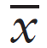
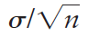
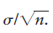
Central Limit Theorem
The Central Limit Theorem for any probability distribution If x possesses any distribution with mean μ and standard deviation σ, then the sample mean based on a random sample of size n will have a distribution that approaches the distribution of a normal random variable with mean μ and standard deviation as n increases without limit. Then the following are true:
(a) The distribution is a normal distribution.
(b) The mean of the distribution is
(c) The standard deviation of the distribution is:
CLT is a wonderful theorem! It states that the distribution will be normal provided the x distribution is normal. The sample size n could be 2, 3, 4, or any (fixed) sample size we wish. Furthermore, the mean of the distribution is m (same as for the x distribution), but the standard deviation is (which is, of course, smaller than s).
http://onlinestatbook.com/stat_sim/sampling_dist/index.html
Notes:
24
24
Örneklem büyüklüğü n arttıkça herhangi bir anakütleden çekilen rassal örneklemlerin ortalamalarının(x) dağılımı ortalaması mü, standart sapması sigma/sqrt(n) olan bir normal dağılıma yaklaşır.

Slide 25
Central Limit Theorem
The central limit theorem is indeed surprising! It says that x can have any distribution whatsoever, but as the sample size gets larger and larger, the distribution of will approach a normal distribution. From this relation, we begin to appreciate the scope and significance of the normal distribution.
In the central limit theorem, the degree to which the distribution of values fits a normal distribution depends on both the selected value of n and the original distribution of x values. A natural question is: How large should the sample size be if we want to apply the central limit theorem? After a great deal of theoretical as well as empirical study, statisticians agree that if n is 30 or larger, the distribution will appear to be normal and the central limit theorem will apply.
However, this rule should not be applied blindly. If the x distribution is definitely not symmetrical about its mean, then the distribution also will display a lack of symmetry. In such a case, a sample size larger than 30 may be required to get a
reasonable approximation to the normal.
http://onlinestatbook.com/stat_sim/sampling_dist/index.html
Notes:
25
25

Slide 26
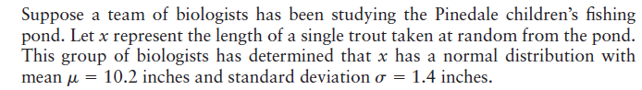
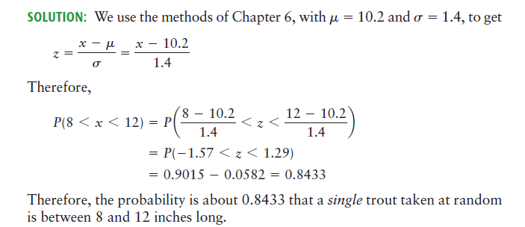
EXAMPLE
Notes:
26
26

Slide 27
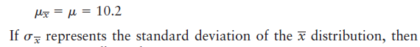
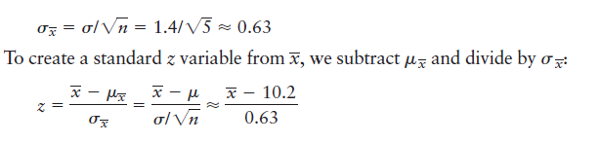
EXAMPLE
Notes:
27
27

Slide 28
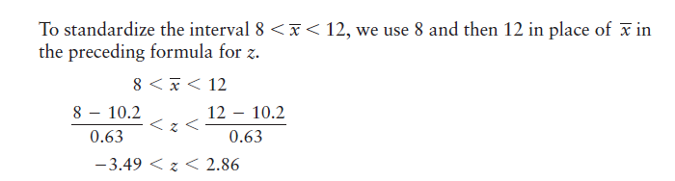
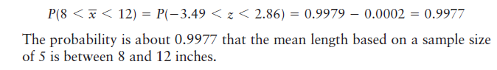
EXAMPLE
Notes:
28
28

Slide 29

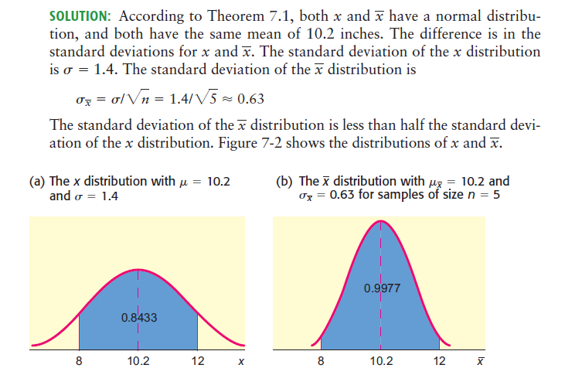
EXAMPLE
Notes:
29
29

Slide 30
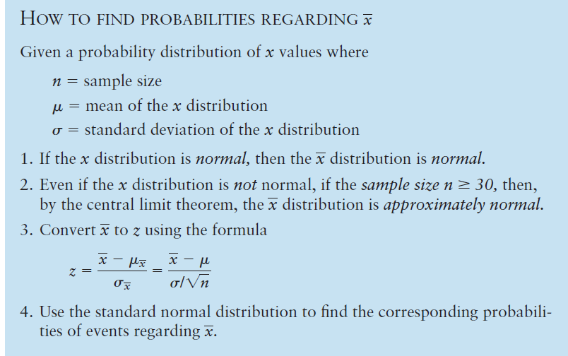
Summary-CLT
Notes:
30
30

Slide 31
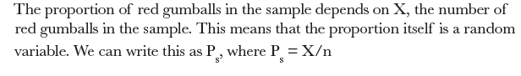
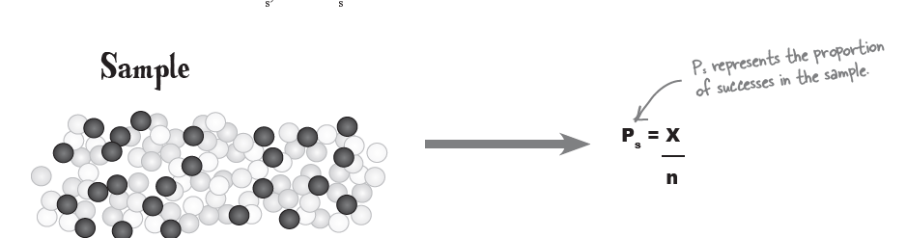
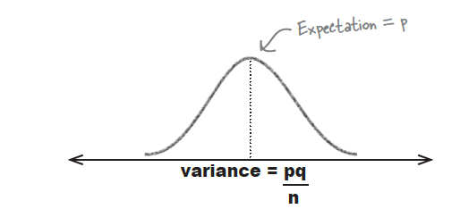
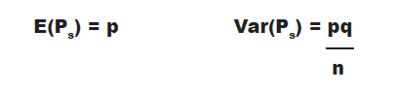
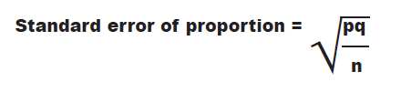
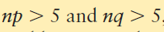
The sampling distribution of proportions
When n is large, the distribution of Ps becomes approximately normal.
By large, we mean greater than 30. The larger n gets, the closer the distribution of P gets to the normal distribution.
Notes:
31
31

Slide 32
Confidence Intervals

Slide 33
The Standard Error
The standard deviation on the second curve has a special name
– statisticians call it the standard error
This can be used to measure the margin of error on a sample mean, helping us assess how close it might be to an unknown, “real” population mean
Distribution of all possible sample means
Population distribution
The 1 s.d. on this curve is called the “standard error”
-1sd
+1sd
-1sd
+1sd
1
1.5
2
2.5
3
3.5
4
2
2.5
3
Mean
Mean
Notes:
33
33

Slide 34
Assessing the accuracy of our sample
OK, so when sampling EVERY combination of values in a population, the mean of all possible means (!) will be the same as the “real” mean
But we usually only take ONE sample, so how does this help us?
How do we know whether our single sample is close to the real population?
Distribution of all possible sample means
Mean from our sample = 2.3
Real population mean = 2.5
Notes:
34
34

Slide 35
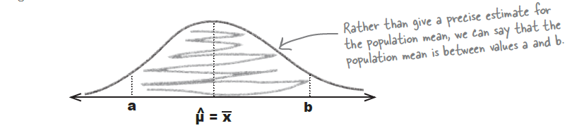
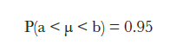
Calculating confidence intervals
The interval limits are chosen so that there’s a specified probability of the population mean being between a and b. As an example, you may want to choose a and b so that there’s a 95% chance of the interval containing the population mean. In other words, you choose a and b so that:
We represent this interval as (a, b). As the exact value of a and b depends on the degree of confidence you want to have that the interval contains the population mean, (a, b) is called a confidence interval.
Notes:
35
35

Slide 36
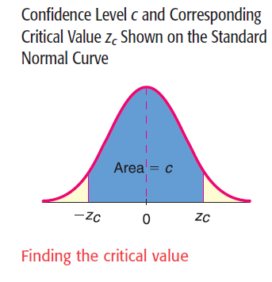
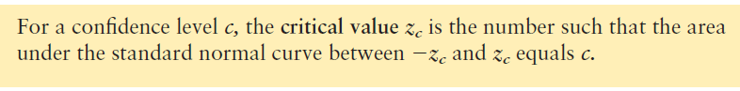
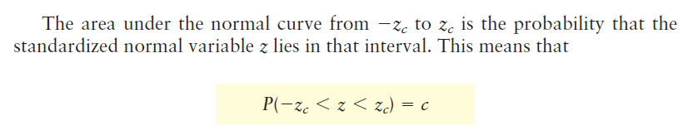
Confidence Interval.
Here :
c is called the confidence level
α = 1-c is called the level of significance
The length of the confidence interval is called the precision of the estimation
Notes:
36
36

Slide 37
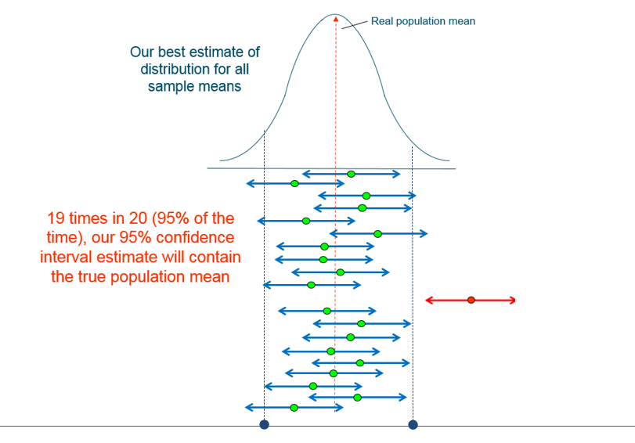
What does 95% confidence in our mean?
Notes:
37
37

Slide 38
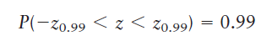
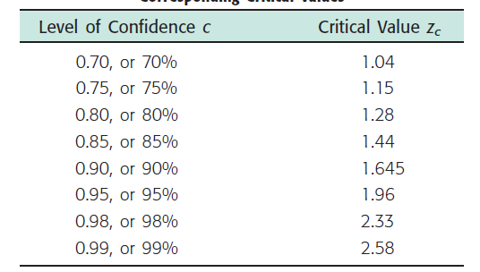


EXAMPLE
Find a number z0.99 such that 99% of the area under the standard normal curve lies between z0.99 and z0.99
Notes:
38
38

Slide 39

Confidence Interval
As sample mean is normally distributed with mean μ and variance σ²/n
Is standard normal and
P(- z_{α/2} ≤ Ζ ≤ z_{α/2}) = 1 – α
Notes:
39
39

Slide 40

Confidence Interval
Notes:
40
40

Slide 41



EXERCISE
Notes:
41
41

Slide 42




Margin of Error
Notes:
42
42

Slide 43
SAMPLE SIZE

Slide 44

HOW TO FIND THE SAMPLE SIZE
Notes:
44
44

Slide 45


EXAMPLE
Notes:
45
45

Slide 46


Confidence intervals based on a percentage
Notes:
46
46

Slide 47


EXAMPLE
Notes:
47
47

Slide 48

HOW TO FIND THE SAMPLE SIZE n FOR ESTIMATING A PROPORTION p
Notes:
48
48

